Slide 1
AMAZON REDSHIFT
Chi Phuong Diep

Slide 2


Amazon Redshift
Cloud data warehouse for large dataset storage & analysis
Amazon-managed, no technical maintenance needed
Supports SQL for quick, complex queries
Scalable & user-friendly
Revolutionizing
Data Management

Slide 3

01.
02.
03.
Data Structures
Product Design
CRUD Operations
Overview of data types and structure used for Amazon product and review datasets
Explore ERD Design and transactional relationship
Implementation of Create, Read, Update, and Delete operations for efficient data management

Slide 4
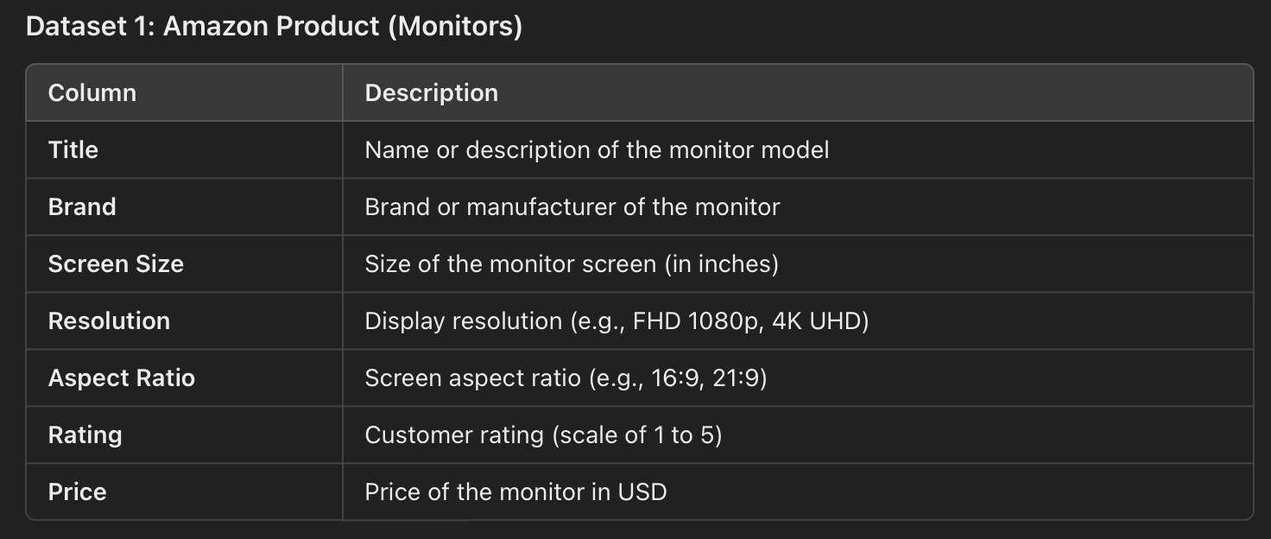

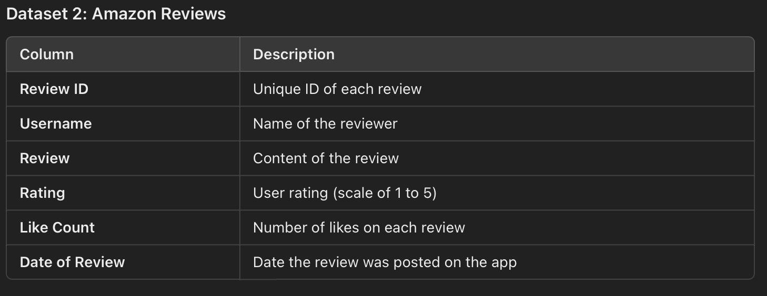

Slide 5





Data Preprocessing
Atomicity:
Each review is a complete transaction, ensuring all related operations are processed together.
Consistency:
Data integrity is upheld with keys; invalid reviews are rejected.
Isolation:
Simultaneous reviews are processed independently to prevent conflicts.
Durability:
Committed data is replicated for permanent storage, even if a node fails.
Special Character Cleaning
Removed non-standard characters and double quotes for compatibility
Text Truncation
Limited reviews to 256 characters to meet VARCHAR limit
Dataset Reduction
Reduced Amazon Reviews from 60,000 to 928 reviews to match monitor count
Data Consistency
Ensured sequential monitorIDs and consistent date format
(YYYY-MM-DD)

Slide 6

01.
02.
03.
Data Structures
Product Design
CRUD Operations
Overview of data types and structure used for Amazon product and review datasets
Explore ERD Design and transactional relationship
Implementation of Create, Read, Update, and Delete operations for efficient data management

Slide 7
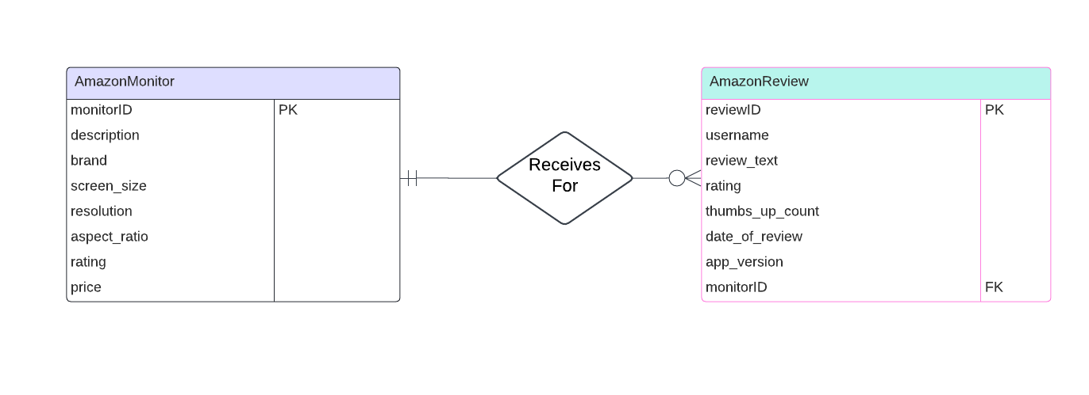
One-to-Many Relationship

Slide 8

01.
02.
03.
Data Structures
Product Design
CRUD Operations
Overview of data types and structure used for Amazon product and review datasets
Explore ERD Design and transactional relationship
Implementation of Create, Read, Update, and Delete operations for efficient data management

Slide 9
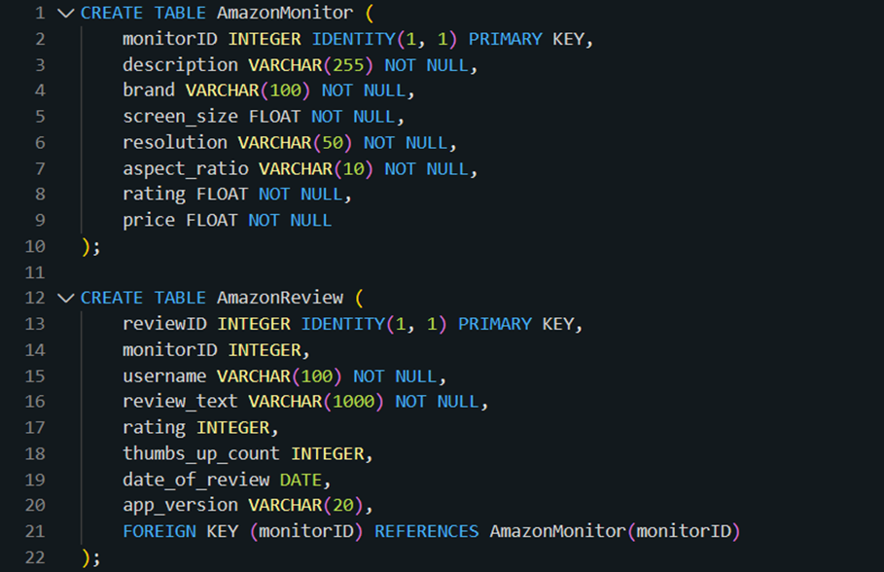
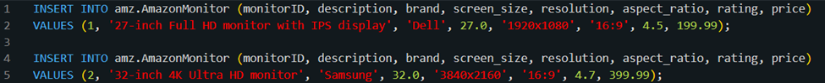
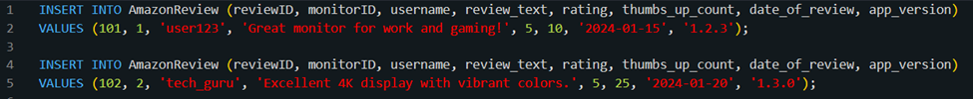
CRUD
Create Monitor
Create Review
Insert Monitor
Insert Review

Slide 10
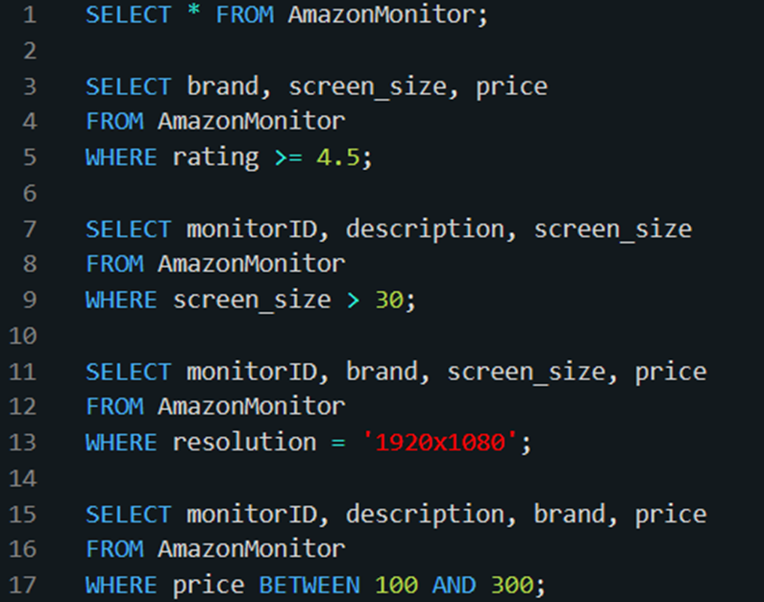
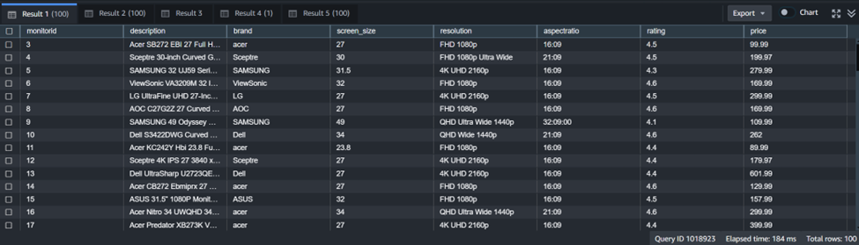
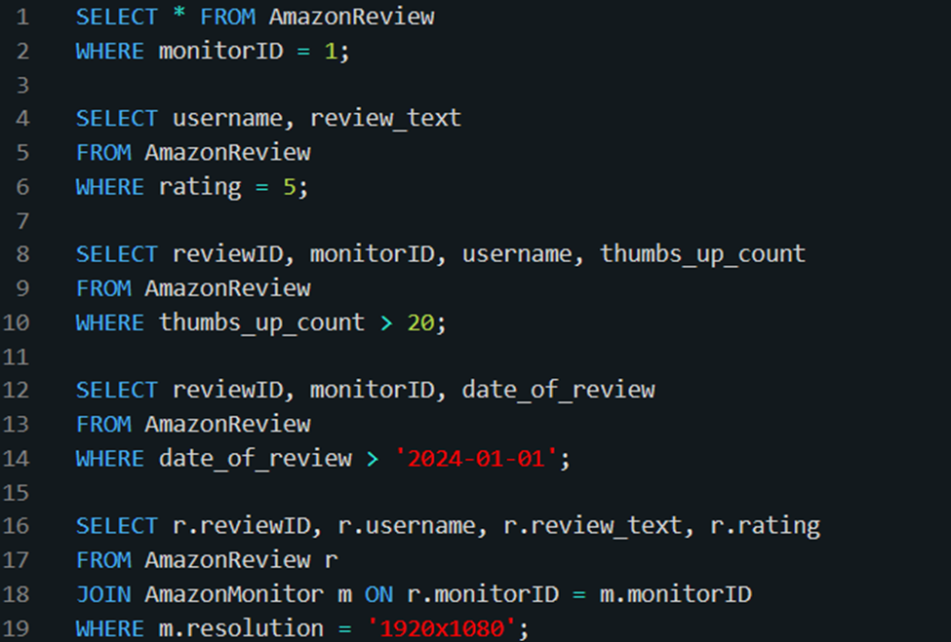
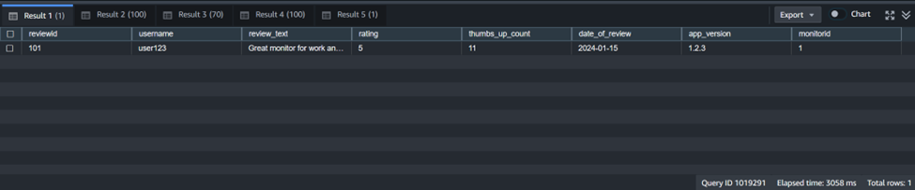
CRUD
Select Monitor
Select Review

Slide 11
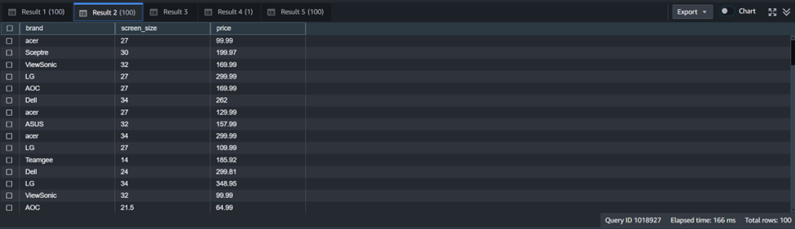
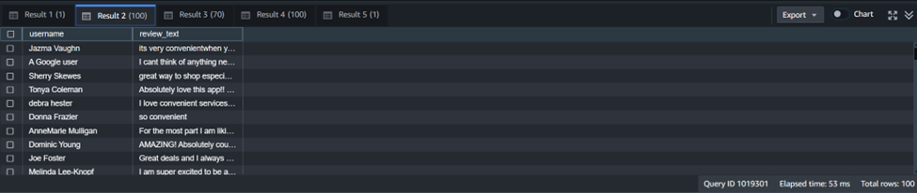
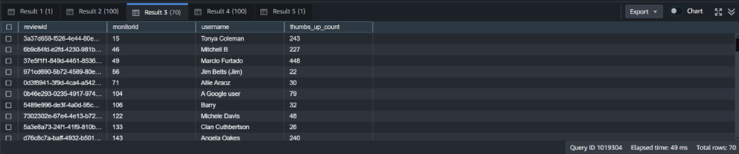
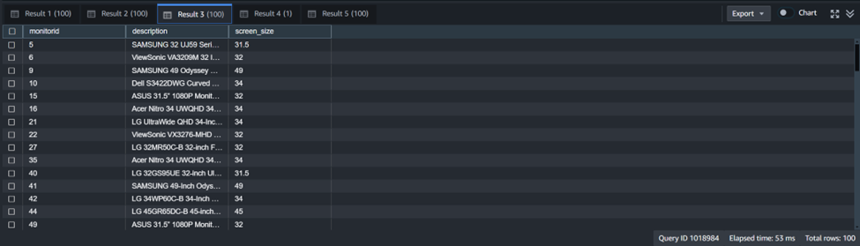
CRUD
Select Monitor
Select Review

Slide 12
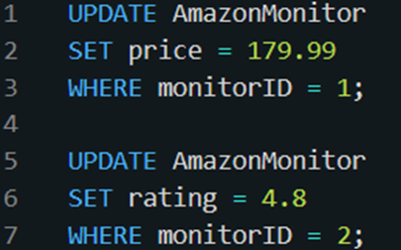
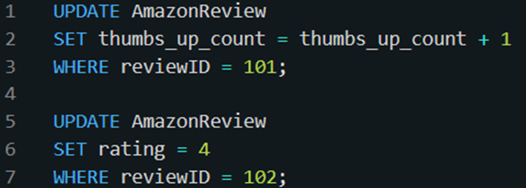
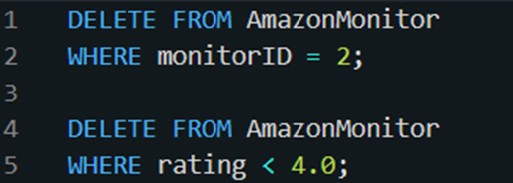
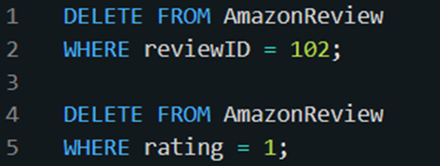
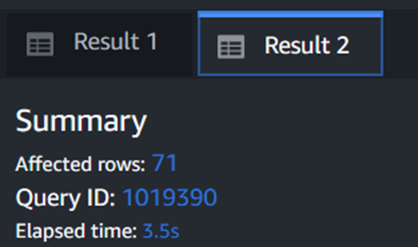
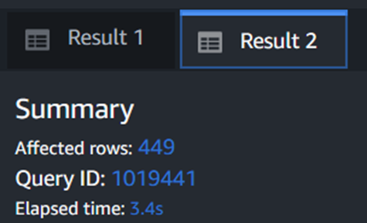
CRUD
Update Monitor
Update Review
Delete Monitor
Delete Review

Slide 13

SUMMARY
Showcased Redshift’s strengths in transactional database design
Efficient data linking and analysis with strong data integrity
User-friendly interface; fast query performance on trial version
Simplified data management with reliable real-time results

